Slide 1
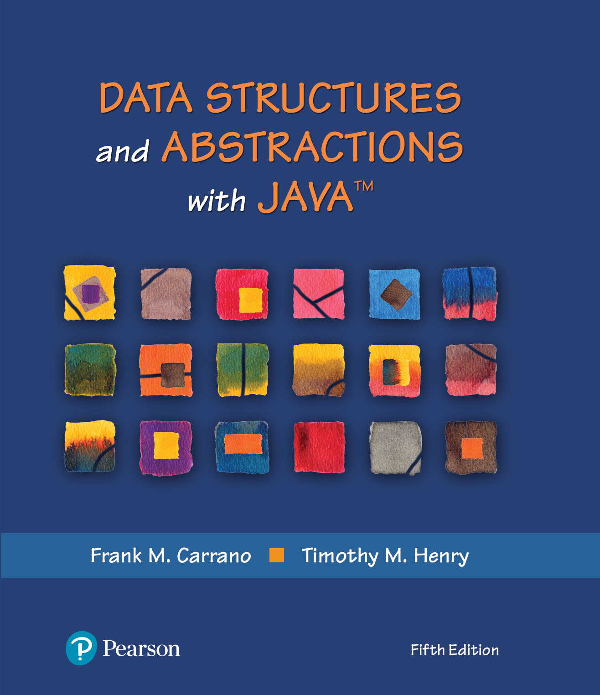
Module 8
Queues, Deques, & Priority Queues; Implementations

Slide 2
Video Notes
ADT Queue
https://mediaplayer.pearsoncmg.com/assets/secs-vn-ch07a-adt-queue
ADTs Deque and Priority Queue
https://mediaplayer.pearsoncmg.com/assets/secs-vn-ch07b-adts-dequeue-and-priority-queue
LinkedQueue
https://mediaplayer.pearsoncmg.com/assets/secs-vn-ch08a-linked-queue
ArrayQueue
https://mediaplayer.pearsoncmg.com/assets/secs-vn-ch08b-array-queue
Other Queue Implementations
https://mediaplayer.pearsoncmg.com/assets/secs-vn-ch08c-other-queue-implementations
Notes:
To maximize your learning experience, prepare for class prior each week

Slide 3
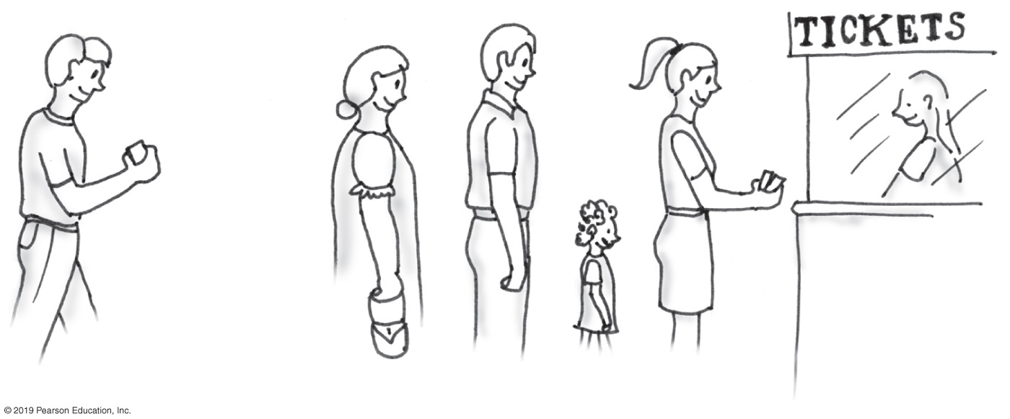
Waiting in Line
A line, or queue, of people

Slide 4
Queue Operations | FIFO
Front

Slide 5
ADT Queue
Pseudocode | UML | Description
enqueue(newEntry) | +enqueue(newEntry: integer): void | Task: Adds a new entry to the back of the queue. Input: newEntry is the new entry. Output: None.
dequeue() | +dequeue(): T | Task: Removes and returns the entry at the front of the queue. Input: None. Output: Returns the queue’s front entry. Throws an exception if the queue is empty before the operation.
getFront() | +getFront(): T | Task: Retrieves the queue’s front entry without changing the queue in any way. Input: None. Output: Returns the queue’s front entry. Throws an exception if the queue is empty.
isEmpty() | +isEmpty(): boolean | Task: Detects whether the queue is empty. Input: None. Output: Returns true if the queue is empty.
clear() | +clear(): void | Task: Removes all entries from the queue. Input: None. Output: None.

Slide 6
ADT Queue
/** An interface for the ADT queue. */
public interface QueueInterface<T>
{
/** Adds a new entry to the back of this queue.
@param newEntry An object to be added. */
public void enqueue(T newEntry);
/** Removes and returns the entry at the front of this queue.
@return The object at the front of the queue.
@throws EmptyQueueException if the queue is empty before the operation. */
public T dequeue();
/** Retrieves the entry at the front of this queue.
@return The object at the front of the queue.
@throws EmptyQueueException if the queue is empty. */
public T getFront();
/** Detects whether this queue is empty.
@return True if the queue is empty, or false otherwise. */
public boolean isEmpty();
/** Removes all entries from this queue. */
public void clear();
} // end QueueInterface

Slide 7
ADT Queue
Entries organized first-in, first-out (FIFO)
Item added first, or earliest, is at the front of the queue
Item added most recently is at the back of the queue
Client can look at or remove only the entry at the front of the queue
Used within operating systems and to simulate real-world events
Come into play whenever processes or events must wait

Slide 8
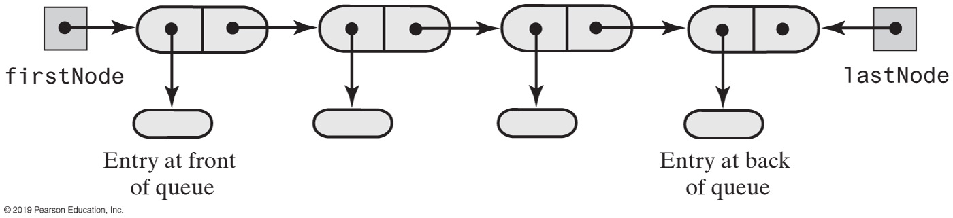
Queue | Linked Implementation
By including a lastNode, implementation becomes much easier
What if we don’t do not utilize a lastNode?

Slide 9
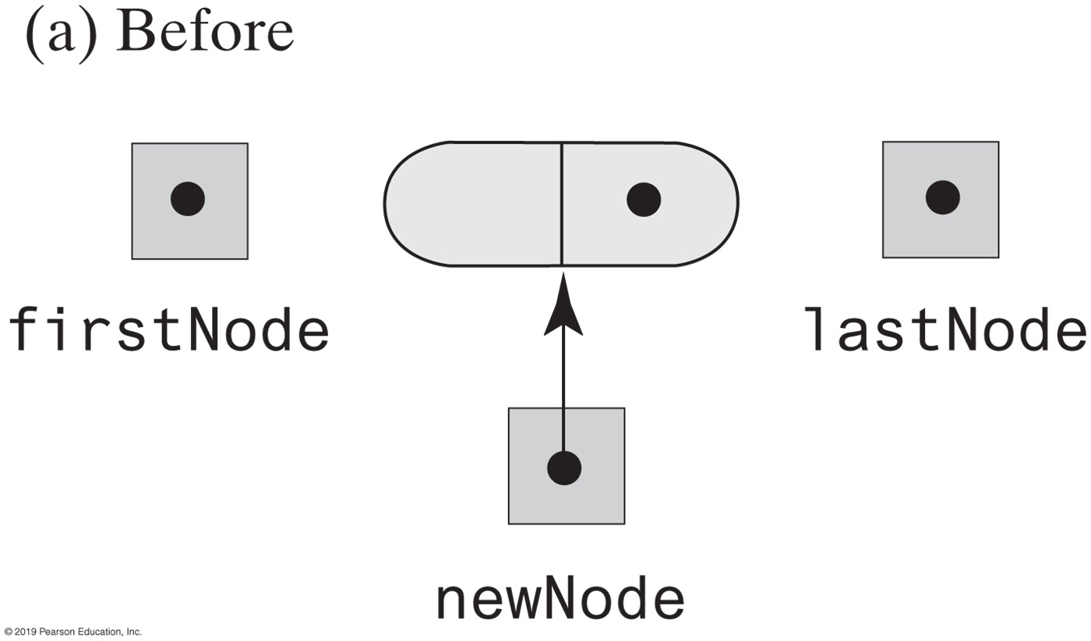
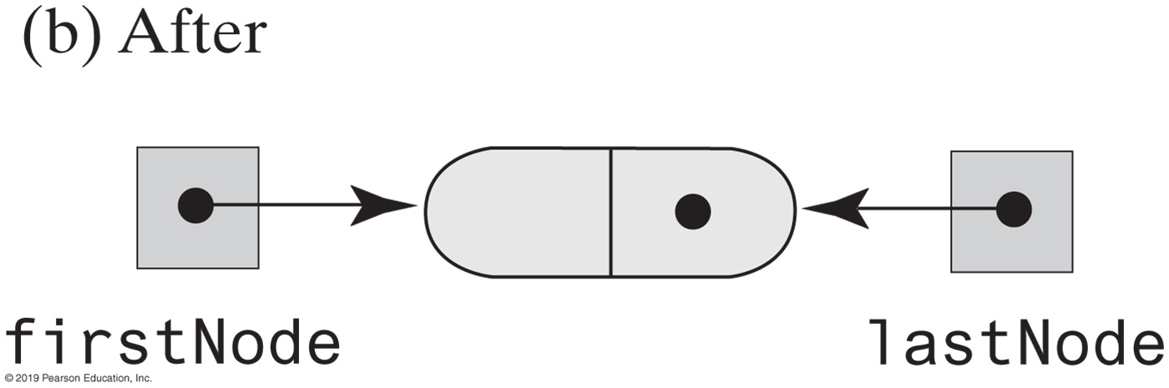
Queue | Linked Implementation
Notes:
New addition to our implementation - lastNode

Slide 10
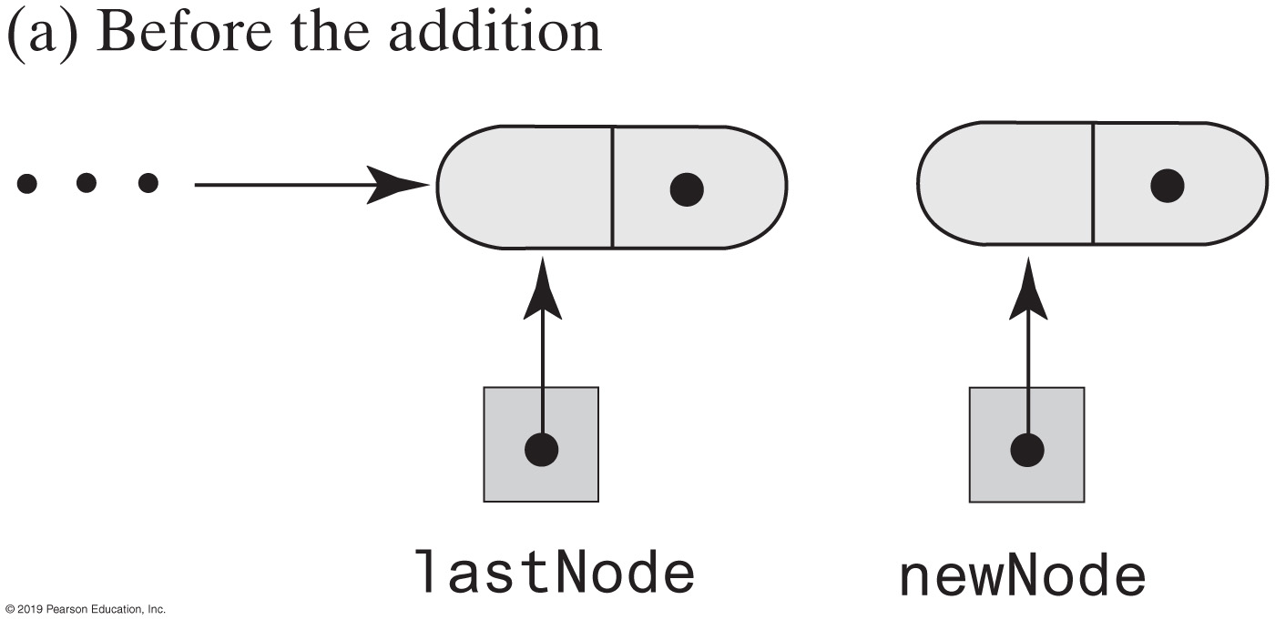
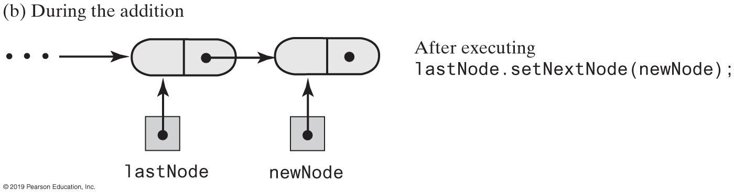
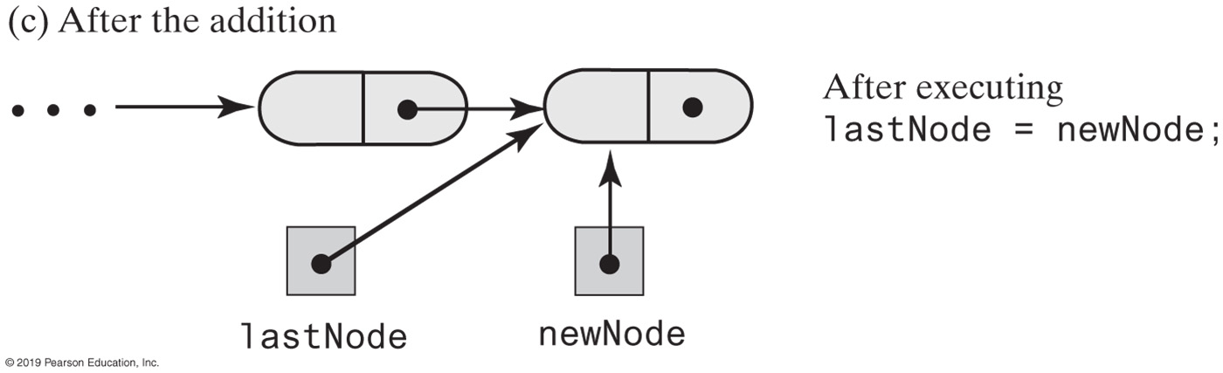
Adding New Node to End of Queue

Slide 11
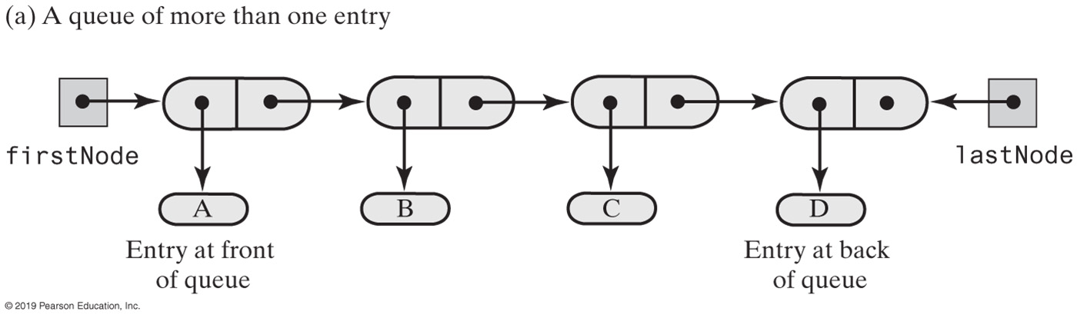
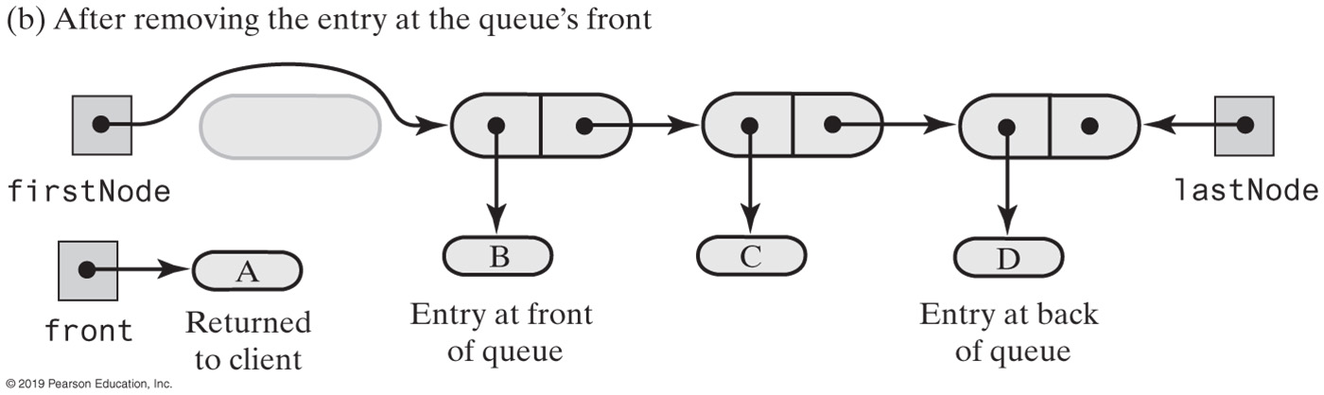
Removing Entry at Front of a Queue

Slide 12
Queue | Linked Implementation
/** A class that implements a queue of objects by using
a chain of linked nodes that has both head and tail references. */
public final class LinkedQueue<T> implements QueueInterface<T>
{
private Node firstNode; // References node at front of queue
private Node lastNode; // References node at back of queue
public LinkedQueue()
{
firstNode = null;
lastNode = null;
} // end default constructor
// < Implementations of the queue operations go here. >
// . . .
private class Node
{
// < Implementation of the inner class Node goes here. >
} // end Node
} // end LinkedQueue

Slide 13
Queue | Linked Implementation
public void enqueue(T newEntry)
{
Node newNode = new Node(newEntry, null);
if (isEmpty())
firstNode = newNode;
else
lastNode.setNextNode(newNode);
lastNode = newNode;
} // end enqueue
enqueue Performance is O(1)

Slide 14
Queue | Linked Implementation
public T dequeue()
{
T front = getFront(); // Might throw EmptyQueueException
// Assertion: firstNode != null
firstNode.setData(null);
firstNode = firstNode.getNextNode();
if (firstNode == null)
lastNode = null;
return front;
} // end dequeue
Removing the front entry

Slide 15
Queue | Linked Implementation
public boolean isEmpty()
{
return (firstNode == null) && (lastNode == null);
} // end isEmpty
public void clear()
{
firstNode = null;
lastNode = null;
} // end clear

Slide 16
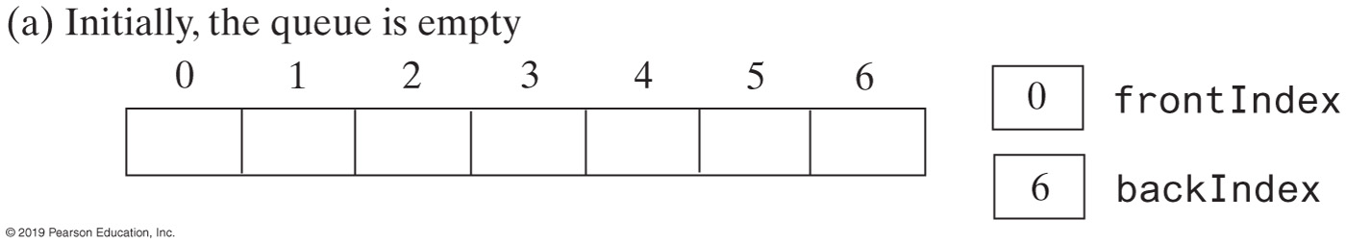
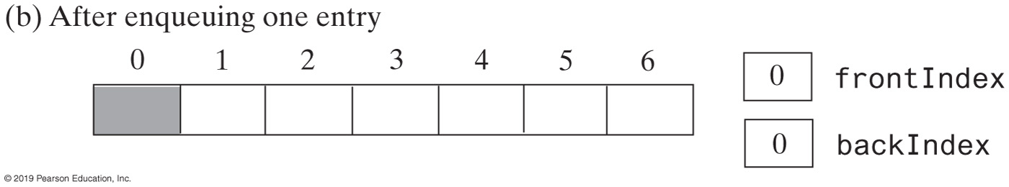
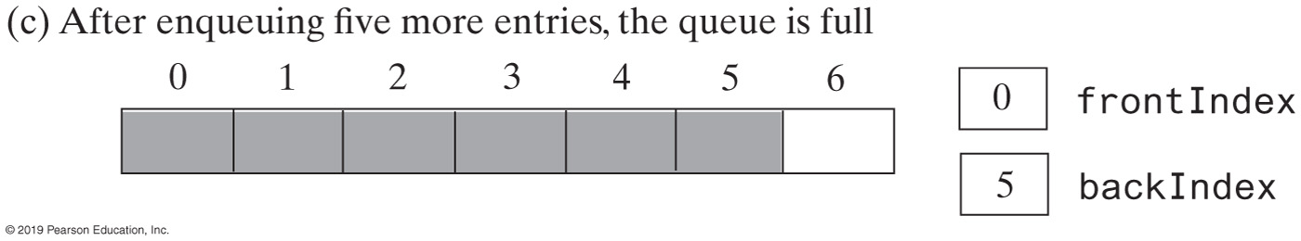
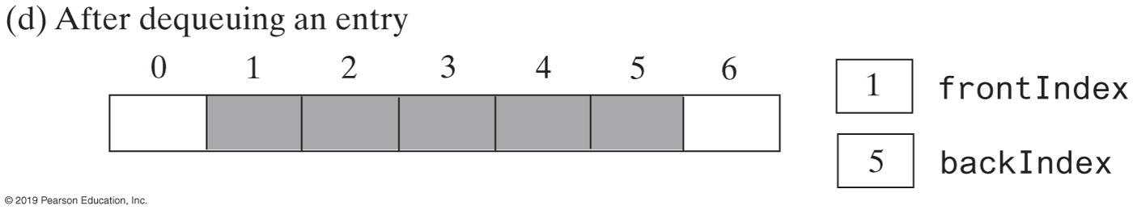
Array Implementation
A seven-element circular array that contains at most six entries of a queue

Slide 17
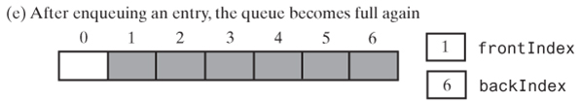
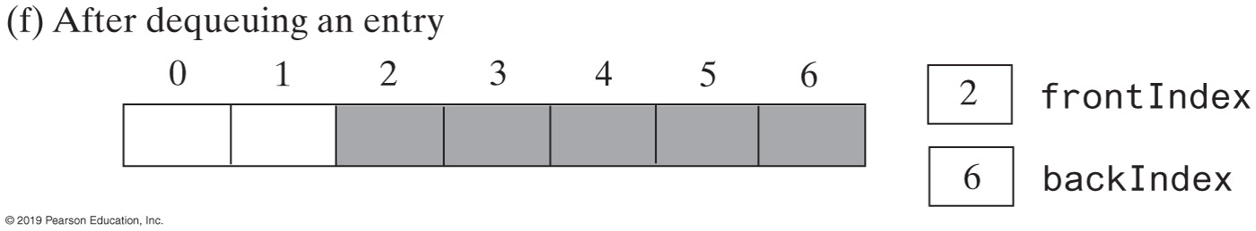
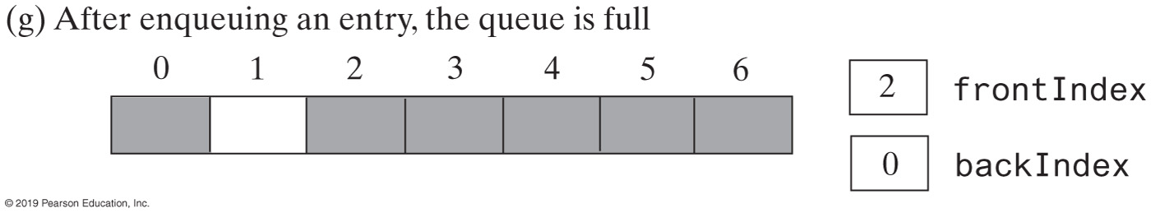
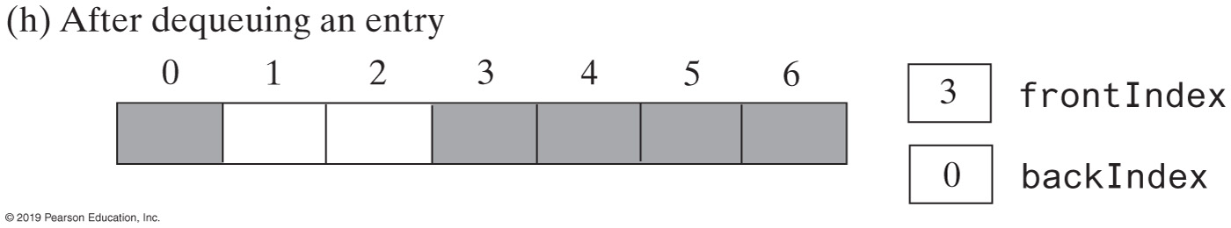
Challenge
A seven-element circular array that contains at most six entries of a queue

Slide 18
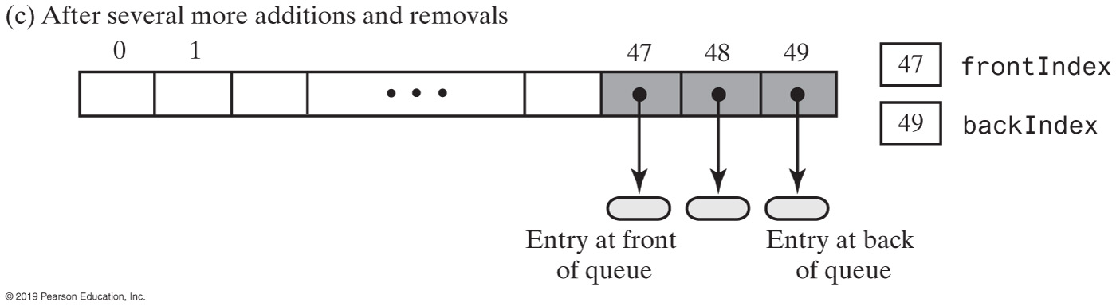
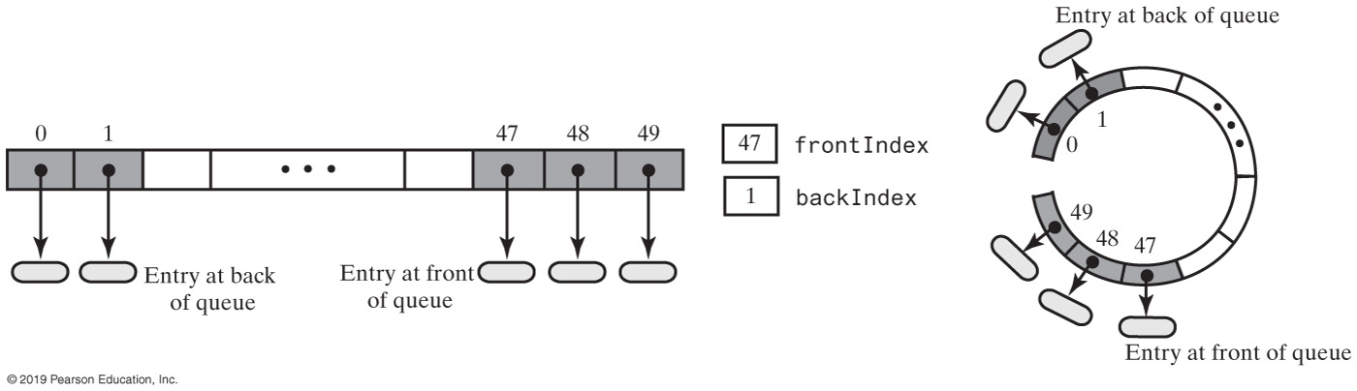
Circular Array
A circular array that represents the queue after adding two more entries
Notes:
What’s a circular array?
Circular vs. “linear” array?
Why should we consider using it?
With this scenario, no point to expand the array just yet! (45 available nodes still)

Slide 19
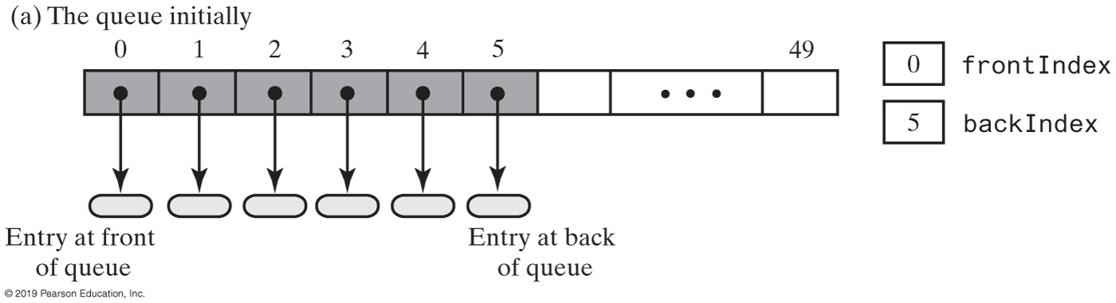
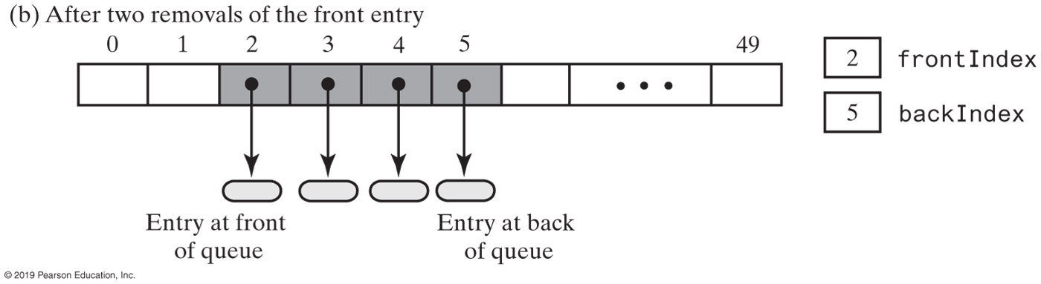
Circular Array with One Unused Location

Slide 20
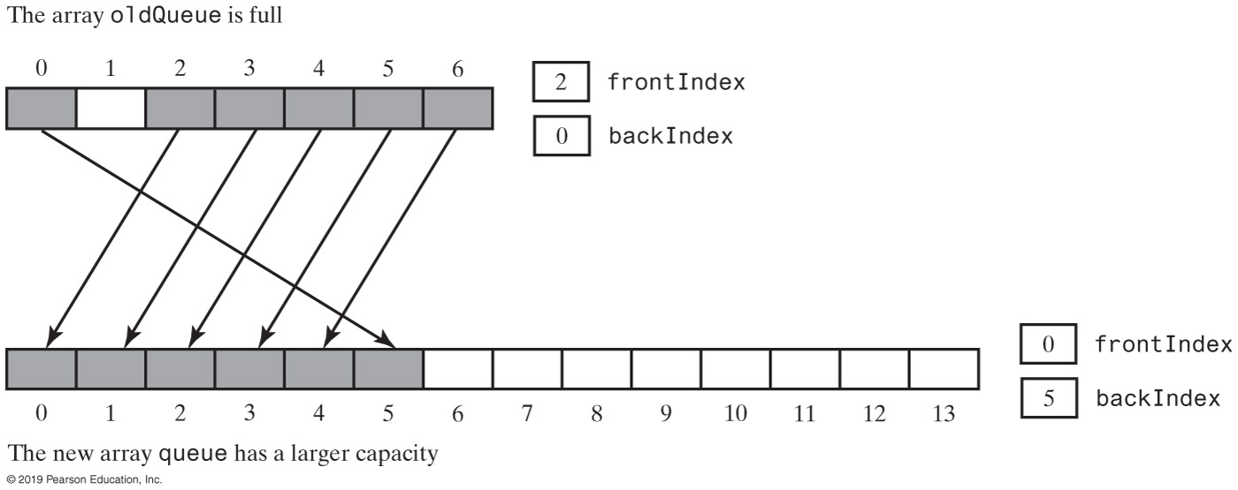
Circular Array with One Unused Location
Doubling the size of an array-based queue
Notes:
While doubling the size, be mindful that we are using a circular array

Slide 21
Circular Array with One Unused Location
public T dequeue()
{
checkIntegrity();
if (isEmpty())
throw new EmptyQueueException();
else
{
T front = queue[frontIndex];
queue[frontIndex] = null;
frontIndex = (frontIndex + 1) % queue.length;
return front;
} // end if
} // end dequeue
Notes:
The % operator

Slide 22
Circular Array with One Unused Location
// Doubles the size of the array queue if it is full.
// Precondition: checkIntegrity has been called.
private void ensureCapacity()
{
if (frontIndex == ((backIndex + 2) % queue.length)) // If array is full,
{ // double size of array
T[] oldQueue = queue;
int oldSize = oldQueue.length;
int newSize = 2 * oldSize;
checkCapacity(newSize);
integrityOK = false;
// The cast is safe because the new array contains null entries
@SuppressWarnings("unchecked")
T[] tempQueue = (T[]) new Object[newSize];
queue = tempQueue;
for (int index = 0; index < oldSize - 1; index++)
{
queue[index] = oldQueue[frontIndex];
frontIndex = (frontIndex + 1) % oldSize;
} // end for
frontIndex = 0;
backIndex = oldSize - 2;
integrityOK = true;
} // end if
} // end ensureCapacity

Slide 23
The Interface Queue(Java Class Library)
https://docs.oracle.com/en/java/javase/11/docs/api/java.base/java/util/Queue.html
Methods
add
offer
remove
poll
element
Peek
isEmpty
size
Notes:
https://docs.oracle.com/en/java/javase/11/docs/api/java.base/java/util/Queue.html
All Known Implementing Classes

Slide 24
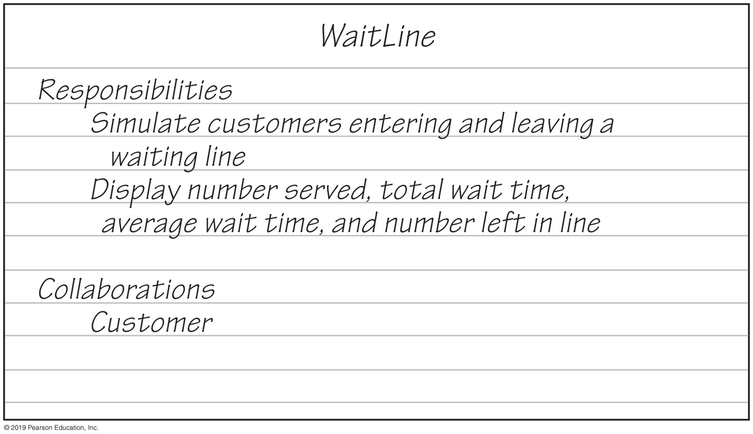
Waiting in Line | Simulation
WaitLine
Responsibilities
Simulate customers entering and leaving a
waiting line
Display number served, total wait time,
average wait time, and number left in line
Collaborations
Customer
A CRC card for the class WaitLine

Slide 25
Waiting in Line | Simulation
WaitLine
line—a queue of customers numberOfArrivals—number of customers numberServed—number of customers actually served totalTimeWaited—total time customers have waited
simulate(duration, arrivalProbability, maxTransactionTime) displayResults()
1
Customer
arrivalTime transactionTime customerNumber
getArrivalTime() getTransactionTime() getCustomerNumber()
*

Slide 26
ADT Priority Queue
Consider how a hospital assigns a priority to each patient that overrides time at which patient arrived.
ADT priority queue organizes objects according to their priorities
Definition of “priority” depends on nature of the items in the queue

Slide 27
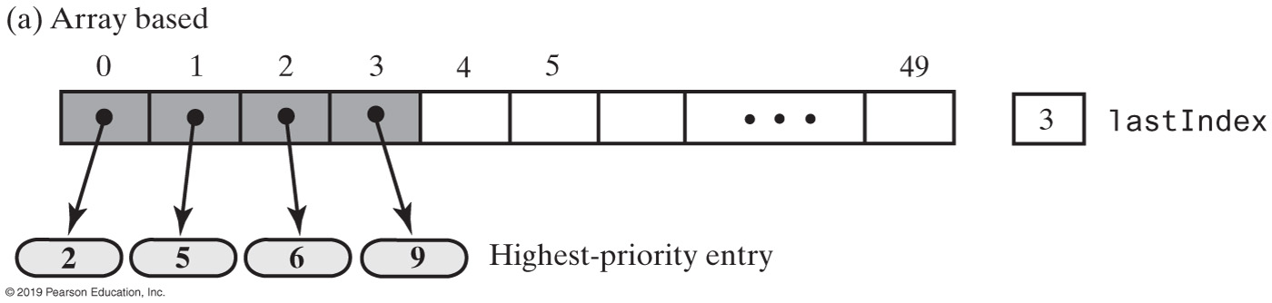
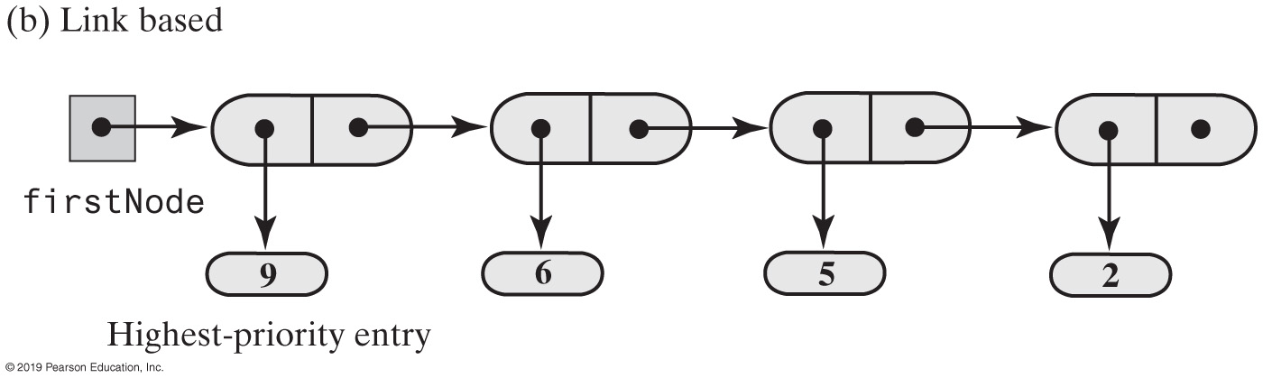
Priority Queue | Possible Implementations
Two possible implementations of a priority queue
Notes:
More to come

Slide 28
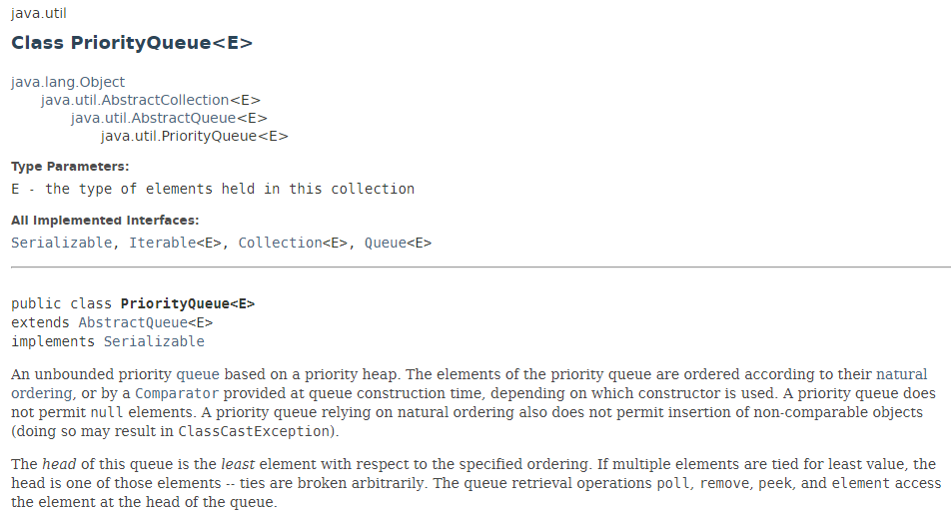
Class PriorityQueue(Java Class Library)
Notes:
We will learn more about what a heap is

Slide 29
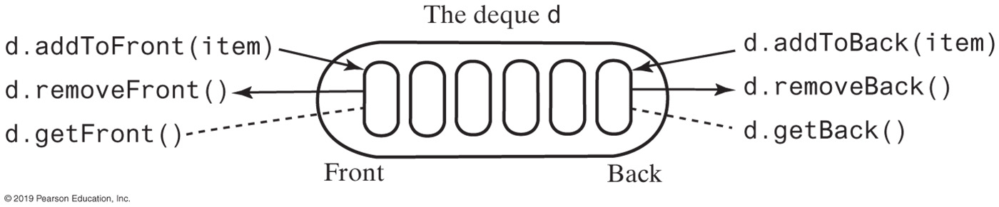
ADT Deque
A double ended queue
Deque pronounced “deck”
It has both queue-like & stack-like operations

Slide 30
Example: Read & Display Keyboard Input
// Read a line
d = a new empty deque
while (not end of line)
{
character = next character read
if (character == ←)
d.removeBack()
else
d.addToBack(character)
}
// Display the corrected line
while (!d.isEmpty())
System.out.print(d.removeFront())
System.out.println()
Pseudocode that uses a deque to read and display a line of keyboard input

Slide 31
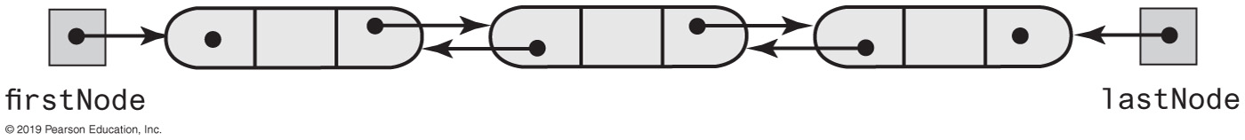
Deque Implementation
A doubly linked chain with head and tail references

Slide 32
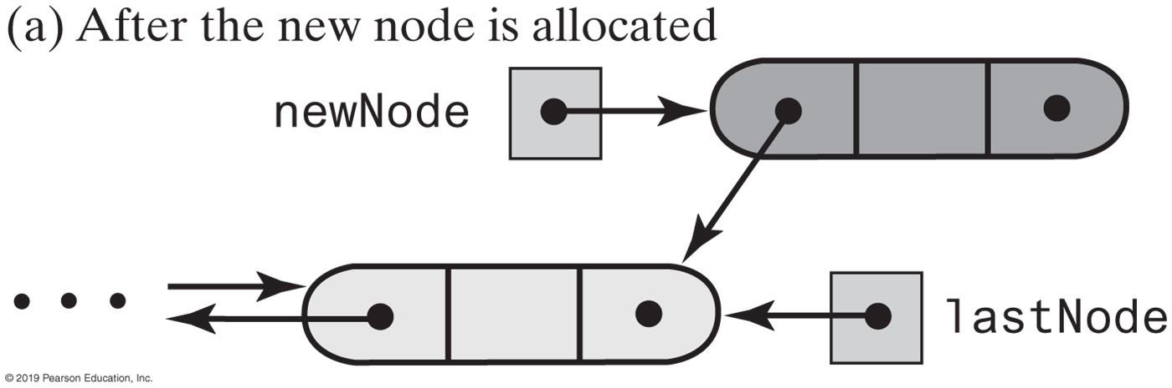
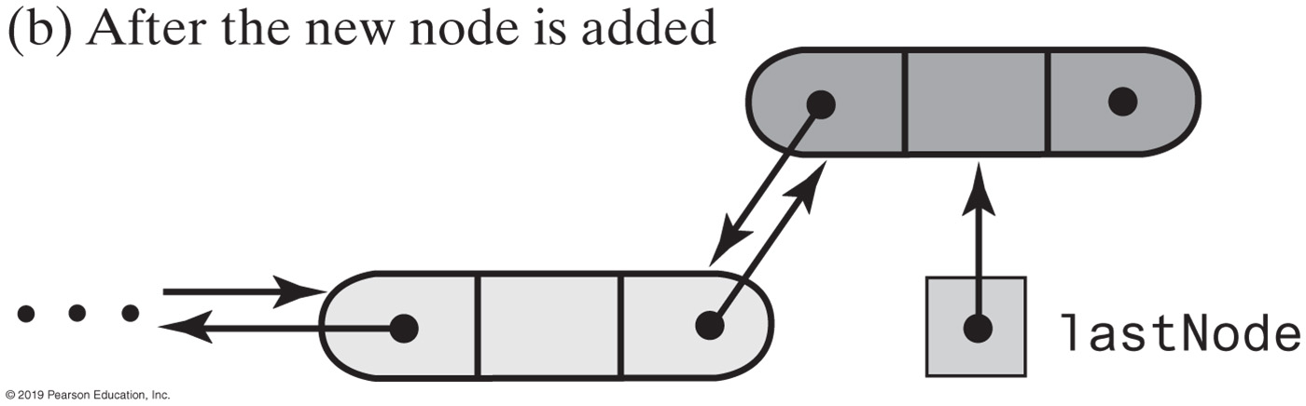
Deque | Implementation
Adding to the back of a nonempty deque

Slide 33
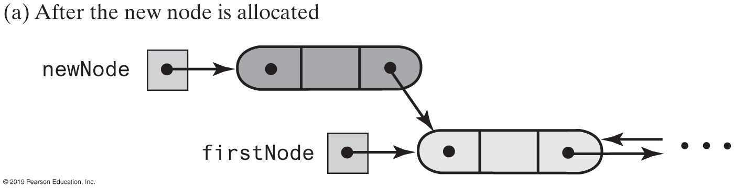
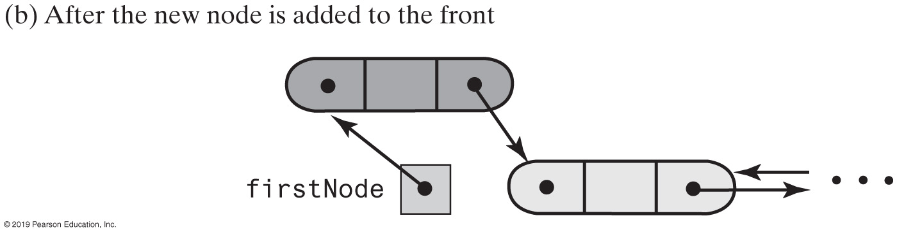
Adding to Front | Nonempty Deque

Slide 34
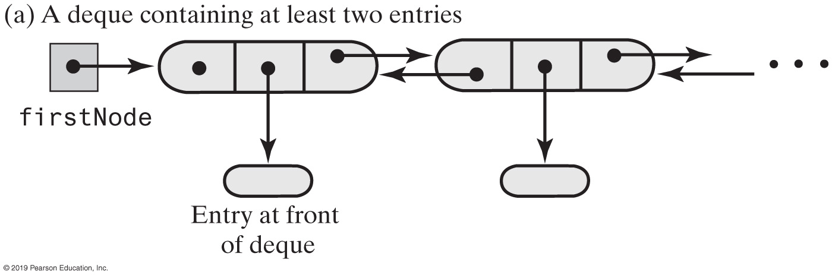
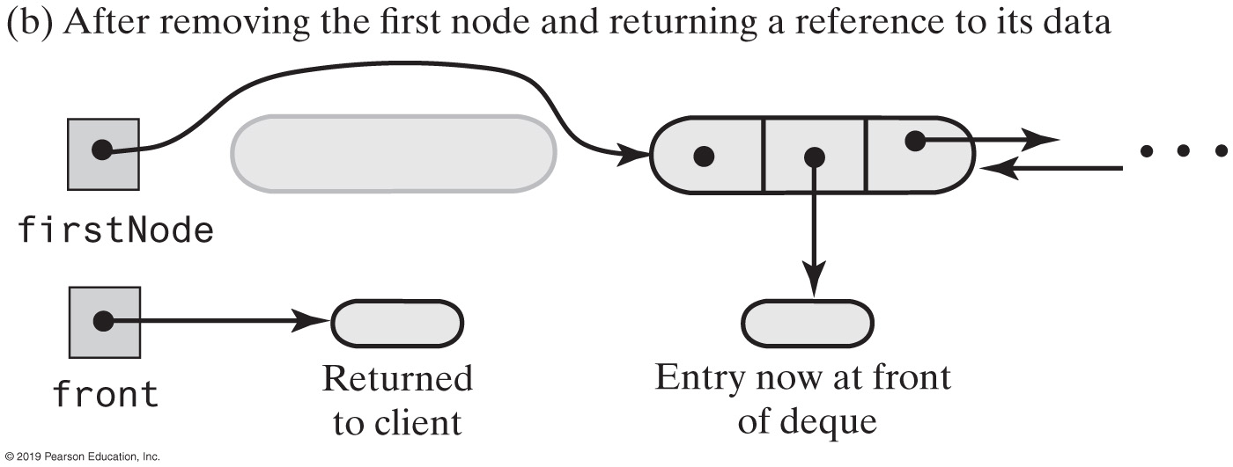
Removing from Front | Deque
Notes:
Removing the front of a deque containing at least two entries

Slide 35
ADT Deque | Interface
/** An interface for the ADT deque. */
public interface DequeInterface<T>
{
/** Adds a new entry to the front/back of this deque.
@param newEntry An object to be added. */
public void addToFront(T newEntry);
public void addToBack(T newEntry);
/** Removes and returns the front/back entry of this deque.
@return The object at the front/back of the deque.
@throws EmptyQueueException if the deque is empty before the
operation. */
public T removeFront();
public T removeBack();
/** Retrieves the front/back entry of this deque.
@return The object at the front/back of the deque.
@throws EmptyQueueException if the deque is empty. */
public T getFront();
public T getBack();
/** Detects whether this deque is empty.
@return True if the deque is empty, or false otherwise. */
public boolean isEmpty();
/* Removes all entries from this deque. */
public void clear();
} // end DequeInterface

Slide 36
Deque | Implementation
/** A class that implements the a deque of objects by using
a chain of doubly linked nodes. */
public final class LinkedDeque<T> implements DequeInterface<T>
{
private DLNode firstNode; // References node at front of deque
private DLNode lastNode; // References node at back of deque
public LinkedDeque()
{
firstNode = null;
lastNode = null;
} // end default constructor
// < Implementations of the deque operations go here. >
// . . .
private class DLNode
{
private T data; // Deque entry
private DLNode next; // Link to next node
private DLNode previous; // Link to previous node
// < Constructors and the methods getData, setData, getNextNode, setNextNode,
// getPreviousNode, and setPreviousNode are here. >
// . . .
} // end DLNode
} // end LinkedDeque
Notes:
final class

Slide 37
Deque Implementation
public void addToBack(T newEntry)
{
DLNode newNode = new DLNode(lastNode, newEntry, null);
if (isEmpty())
firstNode = newNode;
else
lastNode.setNextNode(newNode);
lastNode = newNode;
} // end addToBack

Slide 38
Deque Implementation
public T removeBack()
{
T back = getBack(); // Might throw EmptyQueueException
// Assertion: lastNode != null
lastNode = lastNode.getPreviousNode();
if (lastNode == null)
firstNode = null;
else
lastNode.setNextNode(null);
} // end if
return back;
} // end removeBack
Implementation of removeBack, an O(1) operation

Slide 39
Interface Deque(Java Class Library)
Methods provided
addFirst, offerFirst
addLast, offerLast
removeFirst, pollFirst
removeLast, pollLast
getFirst, peekFirst
getLast, peekLast
isEmpty, clear, size
push, pop

Slide 40
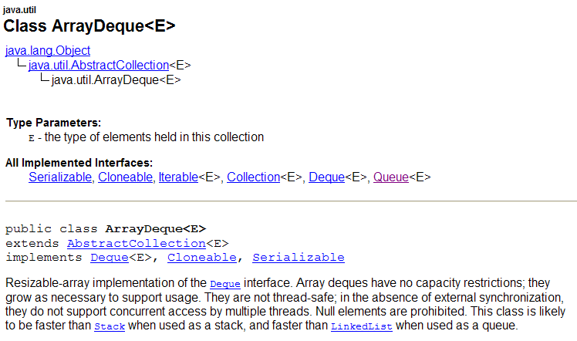
Class ArrayDeque

Slide 41
Class AbstractQueue (Java Class Library)
public boolean add(T newEntry)
public boolean offer(T newEntry)
public T remove()
public T poll()
public T element()
public T peek()
public boolean isEmpty()
public void clear()
public int size()

Slide 42
Tracking Your Assignments | Activity
Assignment
course—the course code task—a description of the assignment date—the due date
getCourseCode() getTask() getDueDate() compareTo()
AssignmentLog
log—a priority queue of assignments
addProject(newAssignment) addProject(courseCode, task, dueDate) getNextProject() removeNextProject()
Notes:
You will need to think about due dates

Slide 43
Waiting in Line | Simulation

Slide 44
Simulating a Waiting Line
/** Simulates a waiting line. */
public class WaitLine
{
private QueueInterface<Customer> line;
private int numberOfArrivals;
private int numberServed;
private int totalTimeWaited;
public WaitLine()
{
line = new LinkedQueue<>();
reset();
} // end default constructor
/** Initializes the simulation. */
public final void reset()
{
line.clear();
numberOfArrivals = 0;
numberServed = 0;
totalTimeWaited = 0;
} // end reset
public void simulate(int duration, double arrivalProbability,
int maxTransactionTime)
{ < implementation on next slide > }
public void displayResults()
{ < implementation on next slide > }
} // end WaitLine

Slide 45
Simulating a Waiting Line
public void simulate(int duration, double arrivalProbability, int maxTransactionTime)
{
int transactionTimeLeft = 0;
for (int clock = 0; clock < duration; clock++)
{
if (Math.random() < arrivalProbability)
{
numberOfArrivals++;
int transactionTime = (int)(Math.random() * maxTransactionTime + 1);
Customer nextArrival = new Customer(clock, transactionTime,
numberOfArrivals);
line.enqueue(nextArrival);
System.out.println("Customer " + numberOfArrivals +
" enters line at time " + clock +
". Transaction time is " + transactionTime);
} // end if
if (transactionTimeLeft > 0)
transactionTimeLeft--;
else if (!line.isEmpty())
{
Customer nextCustomer = line.dequeue();
transactionTimeLeft = nextCustomer.getTransactionTime() - 1;
int timeWaited = clock - nextCustomer.getArrivalTime();
totalTimeWaited = totalTimeWaited + timeWaited;
numberServed++;
System.out.println("Customer " + nextCustomer.getCustomerNumber() +
" begins service at time " + clock +
". Time waited is " + timeWaited);
} // end if
} // end for
} // end simulate

Slide 46
Simulating a Waiting Line
/** Displays summary results of the simulation. */
public void displayResults()
{
System.out.println();
System.out.println("Number served = " + numberServed);
System.out.println("Total time waited = " + totalTimeWaited);
double averageTimeWaited = ((double)totalTimeWaited) / numberServed;
System.out.println("Average time waited = " + averageTimeWaited);
int leftInLine = numberOfArrivals - numberServed;
System.out.println("Number left in line = " + leftInLine);
} // end displayResults

